Slide 1
Creating Access to Wellbeing 360
Step-by-step instructions

Slide 2
Login into https://chiphealthhra.com.au/
Insert your email address.
If you have not used Wellbeing 360 before It will open a new page to allow you to register…

Slide 3
Register your details
Insert the registration code given to you – R6HF7
Insert your details
Keep a copy of your password in a safe place.

Slide 4
Verify your details
This step ensures you have entered the correct email address.
Check your email to locate a message from Wellbeing 360
Insert the 4-digit code into login page.
If you cannot locate an email check your spam box/junk mail.
It may take 1-5 mins for the email with your code to arrive

Slide 5
Log into your account
Congratulations. You have now created an account.
Log into your account with the details just used to create your profile.

Slide 6
Select your class
Click on the ‘Please choose an option’ .
Select your class from those that drop down.
Click on the orange SELECT button

Slide 7
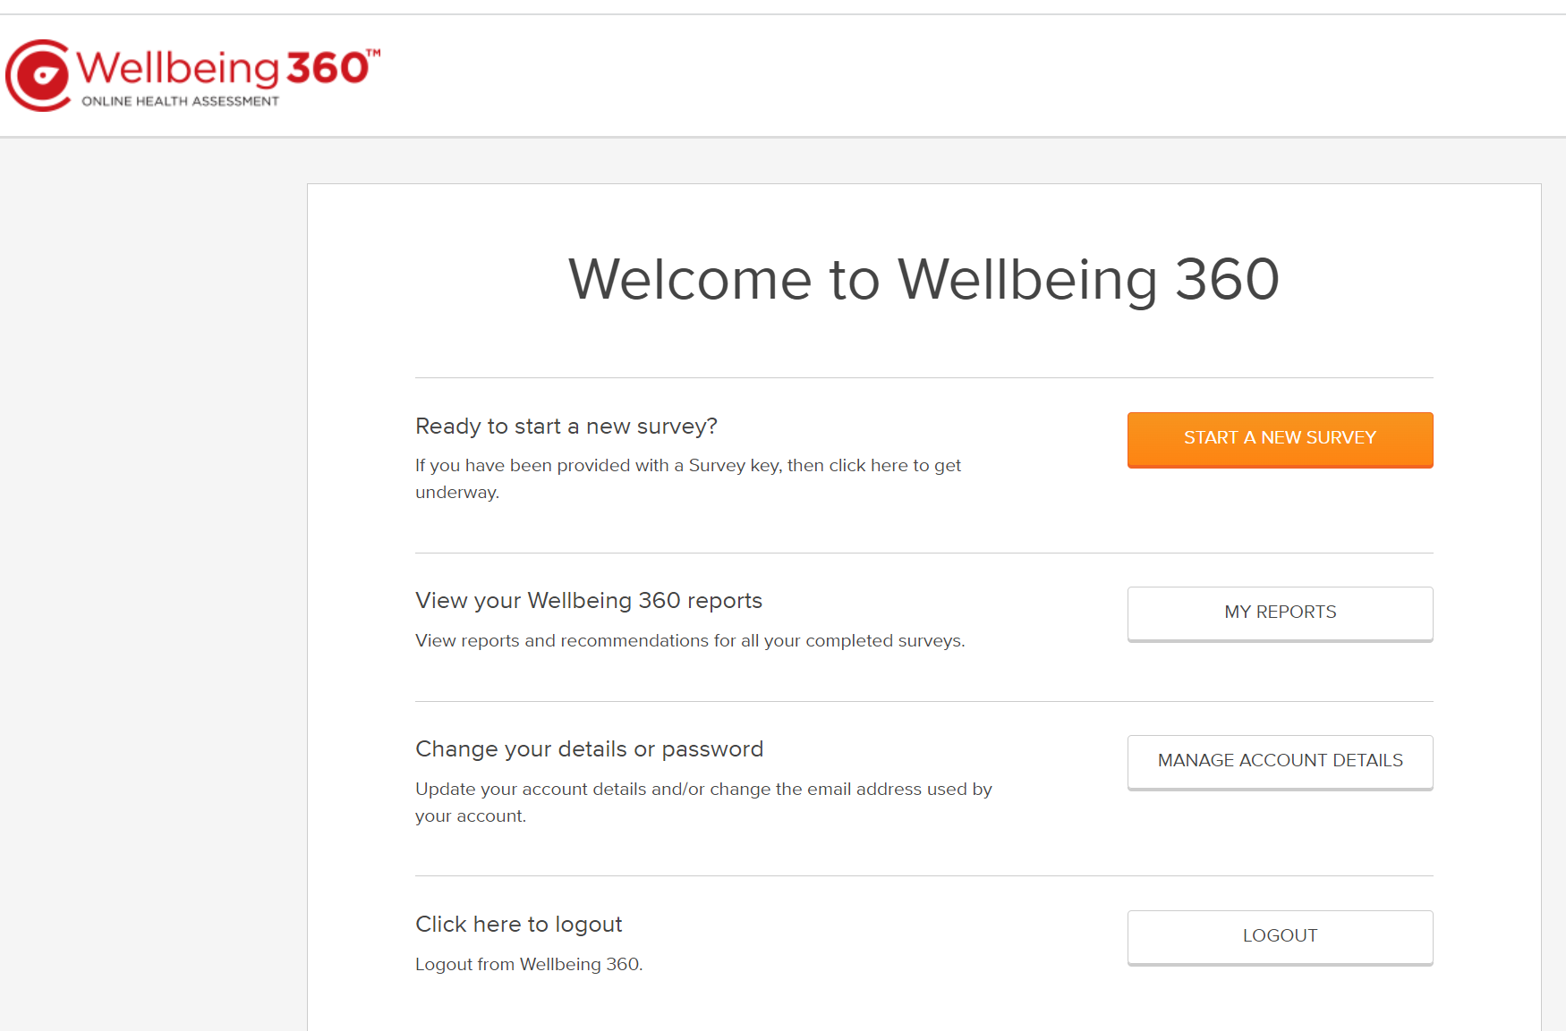
Start a Survey
Click on ‘Start a New Survey’.

Slide 8
Begin the Survey
Click on ‘Begin the Survey’.

Slide 9
Confidentiality Agreement
Read Confidentiality clause.
If you agree, check both boxes and select NEXT
If you do not agree, do not go any further. Close the survey and exit.

Slide 10
Commence Survey
Ensure you have the completed health details form with you, as you will need this information as you progress.

Slide 11
To exit survey
You can save and exit the survey at any time so long as you click the Save and Exit button at the bottom of the page.
To Resume Survey
When you sign back in using your email and password, you will resume at the place you left off.

